Slide 1
Spring Framework
Day 1

Slide 2
what is a Framework?
A framework is a reusable design platform for software systems. It supports code libraries and various scripting languages.
In simple terms, a framework makes programming easier.
There are frameworks for many languages, including Java, Python, PHP, Perl, and Ruby.

Slide 3

What is Spring Framework?
Spring is a lightweight, loosely coupled, and integrated framework for developing Java enterprise applications.
It is a lightweight application framework, similar to a "framework of frameworks."
Spring supports various other frameworks like Struts, JSP, and Hibernate.

Slide 4
Advantages of Spring Framework
There are many advantages of Spring Framework.
Predefined Templates
Loose Coupling
Easy to test
Lightweight
Fast Development
Powerful abstraction
Declarative support

Slide 5
Predefined Templates
Spring framework provides templates for JDBC, Hibernate, JPA etc. technologies.
So, there is no need to write too much code.
Loose Coupling
The Spring applications are loosely coupled because of dependency injection.
Easy to test
The Dependency Injection makes easier to test the application

Slide 6
Light weight
Spring framework is lightweight because of its POJO (Plain Old Java Object) implementation. The Spring Framework doesn't force the programmer to inherit any class or implement any interface.
Fast Development
The Dependency Injection feature of the Spring Framework, along with its support for various frameworks, makes developing JavaEE applications easier.
Powerful abstraction
It provides powerful abstraction to JavaEE specifications such as JMS,JDBC, JPA and JTA.
Declarative support
It provides declarative support for caching, validation, transactions and formatting.

Slide 7
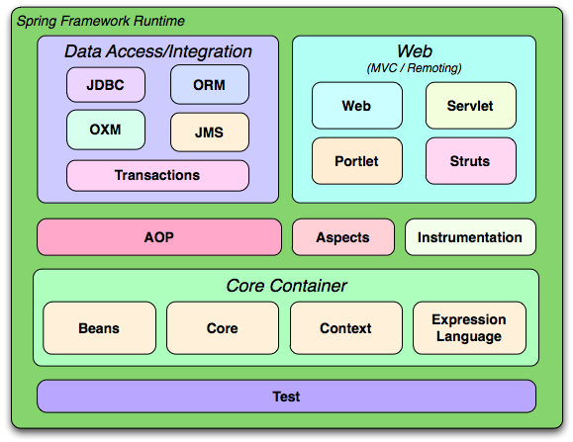
Spring Modules
The Spring framework includes many modules, such as core, beans, context, expression language, AOP, aspects, instrumentation, JDBC, ORM, OXM, JMS, transaction, web, servlet, and Struts.

Slide 8
Spring Core Container :
The Spring Core container contains
Core
beans
context
expressionlanguage (EL) modules.

Slide 9
Core and Beans
These modules provide IOC and Dependency Injection features.
Context
This module supports internationalization (I18N), EJB, JMS, Basic Remoting.
Expression Language
It is an extension to the EL defined in JSP.
It provides support to setting and getting property values, method invocation, accessing collections and indexers, named variables, logical and arithmetic operators, retrieval of objects by name etc.

Slide 10
AOP, Aspects and Instrumentation
These modules support aspect-oriented programming implementation where we can use Advices, Pointcuts etc. to decouple the code.
The aspects module provides support to integration with AspectJ.
The instrumentation module provides support to class instrumentation and class loader implementations.
Test
This layer provides support of testing with JUnit and TestNG.

Slide 11
Data Access / Integration
This group includes the JDBC, ORM, OXM, JMS, and transaction modules.
These modules mainly provide support for interacting with the database.
Web
This group includes the Web, Web-Servlet, Web-Struts and Web-Portlet.
These modules provide support to create web application

Slide 12
Spring Framework
Day 2

Slide 13
What is Dependency Injection ?
Injecting Dependence of an object from outside is known as Dependency Injection.
Spring framework provides two ways to inject dependency
By Constructor
By Setter method

Slide 14
Difference between constructor and setter injection :
Partial Dependency:
can be injected using setter injection but it is not possible by constructor. Suppose there are 3 properties in a class, having 3 arg constructor and setters methods. In such case, if you want to pass information for only one property, it is possible by setter method only.
Overriding:
Setter injection overrides the constructor injection. If we use both constructor and setter injection, IOC container will use the setter injection.
Changes:
We can easily change the value by setter injection. It doesn't create a new bean instance always like constructor. So setter injection is flexible than constructor injection.

Slide 15
Auto-wiring in Spring :
Auto-wiring feature of spring framework enables you to inject the object dependency implicitly.
It internally uses setter or constructor injection.
Auto-wiring can't be used to inject primitive and string values. It works with reference only.

Slide 16
Advantage of Auto-wiring:
It requires the less code because we don't need to write the code to inject the dependency explicitly.
Disadvantage of Auto-wiring:
No control of programmer.
It can't be used for primitive and string values.

Slide 17
IoC Container
The IoC container is responsible to instantiate, configure and assemble the objects.
The IoC container gets information from the XML or Annotations.
There are two types of IoC containers.
Bean Factory
Application Context

Slide 18
Bean Factory is the basic container.
Resource resourse = new ClassPathResource("applicationContext.xml");
BeanFactory factory = new XmlBeanFactory(resource);
Application context is the advanced container. Applicationcontext extends the bean factory interface.
ApplicationContext context =new ClassPathXmlApplicationContext("applicationContext.xml");

Slide 19
The main tasks performed by IoC container are:
To instantiate the application class
To configure the object
To assemble the dependencies between the objects

Slide 20
Hands-on
Constructor Dependency hands-on videos:
Video link : https://youtu.be/LC7S-uirjUQ
Video link : https://youtu.be/UNc47-ncB18
Setter Dependency hands-on videos:
Video link : https://youtu.be/yUp0hBVZ7Z0
Video link : https://youtu.be/k6UAAjZfbXY
Auto-wiring :
Video link : https://youtu.be/-E4Y8CuNgWc

